Slide 1


ADemonstration Of TextInput And Validation With Android Compose
Project Title:Android Application Development
NM_ID:
Team members
Kirthick raj V
Prabakar V Abinesh S S Praveen raj V
Sathish G

Slide 2


DESCRIPTION
In this demonstration, we'll create an Android app using Jetpack Compose that includes a TextInput field (using TextField) with basic validation logic. The app will validate the input text as the user types and provide real-time feedback. For instance:
If the text is empty, an error message will be displayed. If the input meets the criteria, the error message will disappear.
Features:
1.TextInput Field: A user-friendly input field.
2.Validation Feedback: Real-time validation with a dynamic error message.
3.Material Design Styling: Leveraging Material 3 for a modern UI.

Slide 3
Main Activity.java:
package com.example.surveyapplication import android.content.Context import android.content.Intent import android.os.Bundle import androidx.activity.ComponentActivity import androidx.activity.compose.setContent import androidx.compose.foundation.Image import androidx.compose.foundation.layout.* import androidx.compose.material.* import androidx.compose.runtime.* import androidx.compose.ui.Alignment import androidx.compose.ui.Modifier import androidx.compose.ui.graphics.Color import androidx.compose.ui.layout.ContentScale import androidx.compose.ui.res.painterResource import androidx.compose.ui.text.style.TextAlign import androidx.compose.ui.tooling.preview.Preview import androidx.compose.ui.unit.dp import androidx.compose.ui.unit.sp import com.example.surveyapplication.ui.theme.SurveyApplicationTheme

Slide 4
class MainActivity : ComponentActivity() { private lateinit var databaseHelper: SurveyDatabaseHelper override fun onCreate(savedInstanceState: Bundle?) { super.onCreate(savedInstanceState) databaseHelper = SurveyDatabaseHelper(this) setContent { FormScreen(this, databaseHelper) } } } @Composable fun FormScreen(context: Context, databaseHelper: SurveyDatabaseHelper) { Image( painterResource(id = R.drawable.background), contentDescription = "", alpha =0.1F, contentScale = ContentScale.FillHeight, modifier = Modifier.padding(top = 40.dp) ) // Define state for form fields var name by remember { mutableStateOf("") } var age by remember { mutableStateOf("") } var mobileNumber by remember { mutableStateOf("") } var genderOptions = listOf("Male", "Female", "Other") var selectedGender by remember { mutableStateOf("") } var error by remember { mutableStateOf("") }

Slide 5
var diabeticsOptions = listOf("Diabetic", "Not Diabetic")
var selectedDiabetics by remember { mutableStateOf("") } Column(
modifier = Modifier.padding(24.dp), horizontalAlignment = Alignment.Start, verticalArrangement = Arrangement.SpaceEvenly
) {
Text(
fontSize = 36.sp, textAlign = TextAlign.Center, text = "Survey on Diabetics", color = Color(0xFF25b897)
) Spacer(modifier = Modifier.height(24.dp)) Text(text = "Name :", fontSize = 20.sp) TextField(
value = name, onValueChange = { name = it },
) Spacer(modifier = Modifier.height(14.dp)) Text(text = "Age :", fontSize = 20.sp) TextField(
value = age,

Slide 6
onValueChange = { age = it }, ) Spacer(modifier = Modifier.height(14.dp)) Text(text = "Mobile Number :", fontSize = 20.sp) TextField( value = mobileNumber, onValueChange = { mobileNumber = it }, ) Spacer(modifier = Modifier.height(14.dp)) Text(text = "Gender :", fontSize = 20.sp) RadioGroup( options = genderOptions, selectedOption = selectedGender, onSelectedChange = { selectedGender = it } ) Spacer(modifier = Modifier.height(14.dp))
Text(text = "Diabetics :", fontSize = 20.sp) RadioGroup(
options = diabeticsOptions, selectedOption = selectedDiabetics, onSelectedChange = { selectedDiabetics = it }
)

Slide 7
Text(
text = error, textAlign = TextAlign.Center, modifier = Modifier.padding(bottom = 16.dp)
) // Display Submit button Button(
onClick = { if (name.isNotEmpty() && age.isNotEmpty() && mobileNumber.isNotEmpty() &&
genderOptions.isNotEmpty() && diabeticsOptions.isNotEmpty()) {
val survey = Survey(
id = null, name = name, age = age, mobileNumber = mobileNumber, gender = selectedGender, diabetics = selectedDiabetics
) databaseHelper.insertSurvey(survey) error = "Survey Completed"
} else {
error = "Please fill all fields"
} }, colors = ButtonDefaults.buttonColors(backgroundColor = Color(0xFF84adb8)), modifier = Modifier.padding(start = 70.dp).size(height = 60.dp, width = 200.dp) Text(text = "Submit")
) { }

Slide 8
} @Composable fun RadioGroup(
}
) {
options: List<String>, selectedOption: String?, onSelectedChange: (String) -> Unit Column {
options.forEach { option ->
Row(
Modifier
.fillMaxWidth() .padding(horizontal = 5.dp)
) {
RadioButton(
selected = option == selectedOption, onClick = { onSelectedChange(option) }
) Text(
text = option, style = MaterialTheme.typography.body1.merge(),
modifier = Modifier.padding(top = 10.dp),
fontSize = 17.sp
)
}
}
}

Slide 9
package com.example.surveyapplication import android.content.Context import android.content.Intent import android.os.Bundle import androidx.activity.ComponentActivity import androidx.activity.compose.setContent import androidx.compose.foundation.Image import androidx.compose.foundation.background import androidx.compose.foundation.layout.* import androidx.compose.material.* import androidx.compose.runtime.* import androidx.compose.ui.Alignment import androidx.compose.ui.Modifier import androidx.compose.ui.graphics.Color import androidx.compose.ui.layout.ContentScale import androidx.compose.ui.res.painterResource import androidx.compose.ui.text.font.FontFamily import androidx.compose.ui.text.font.FontWeight import androidx.compose.ui.tooling.preview.Preview import androidx.compose.ui.unit.dp import androidx.compose.ui.unit.sp import androidx.core.content.ContextCompat import com.example.surveyapplication.ui.theme.SurveyApplicationTheme

Slide 10
class LoginActivity : ComponentActivity() {
} @Composable fun LoginScreen(context: Context, databaseHelper: UserDatabaseHelper) {
private lateinit var databaseHelper: UserDatabaseHelper override fun onCreate(savedInstanceState: Bundle?) {
super.onCreate(savedInstanceState) databaseHelper = UserDatabaseHelper(this) setContent {
LoginScreen(this, databaseHelper)
}
}
var username by remember { mutableStateOf("") } var password by remember { mutableStateOf("") } var error by remember { mutableStateOf("") } Column(
modifier = Modifier.fillMaxSize().background(Color.White), horizontalAlignment = Alignment.CenterHorizontally, verticalArrangement = Arrangement.Center
) {
Image(painterResource(id = R.drawable.survey_login), contentDescription = "") Text(

Slide 11
fontSize = 36.sp, fontWeight = FontWeight.ExtraBold, fontFamily = FontFamily.Cursive, color = Color(0xFF25b897), text = "Login" ) Spacer(modifier = Modifier.height(10.dp))
TextField(
value = username, onValueChange = { username = it }, label = { Text("Username") }, modifier = Modifier
.padding(10.dp) .width(280.dp)
) TextField(
value = password, onValueChange = { password = it }, label = { Text("Password") }, visualTransformation = PasswordVisualTransformation(), modifier = Modifier
.padding(10.dp) .width(280.dp)
) if (error.isNotEmpty()) {

Slide 12
Text( text = error, color = MaterialTheme.colors.error, modifier = Modifier.padding(vertical = 16.dp) ) } Button( onClick = { if (username.isNotEmpty() && password.isNotEmpty()) {
val user = databaseHelper.getUserByUsername(username) if (user != null && user.password == password) {
error = "Successfully log in" context.startActivity(
Intent(
context, MainActivity::class.java
)
) //onLoginSuccess()
} if (user != null && user.password == "admin") {
error = "Successfully log in" context.startActivity(
Intent(
context, AdminActivity::class.java
)
)

Slide 13
} else { error = "Invalid username or password" } } else { error = "Please fill all fields" } },
colors = ButtonDefaults.buttonColors(backgroundColor = Color(0xFF84adb8)), modifier = Modifier.padding(top = 16.dp) Text(text = "Login")
) { } Row {
TextButton(onClick = {context.startActivity(
Intent(
context, RegisterActivity::class.java
)
)} ) { Text(color = Color(0xFF25b897),text = "Register") } TextButton(onClick = { }) {
Spacer(modifier = Modifier.width(60.dp)) Text(color = Color(0xFF25b897),text = "Forget password?")

Slide 14
} } } } private fun startMainPage(context: Context) { val intent = Intent(context, MainActivity::class.java)
}
ContextCompat.startActivity(context, intent, null)

Slide 15
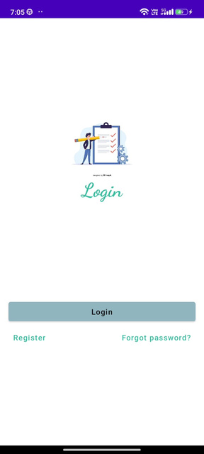
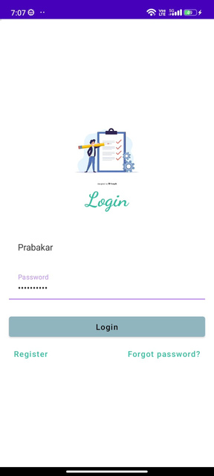
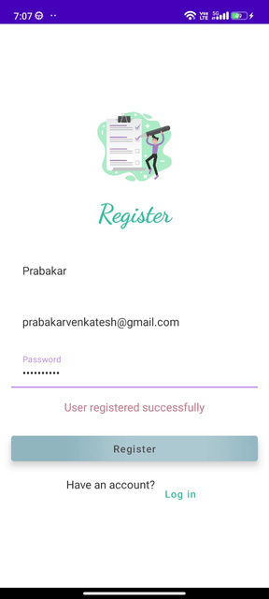
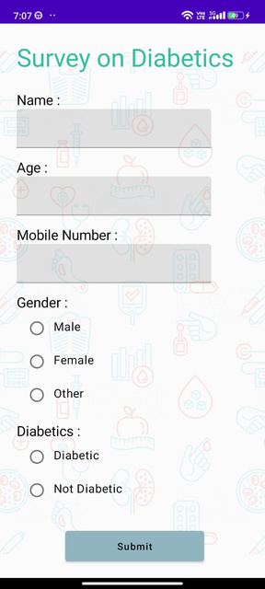
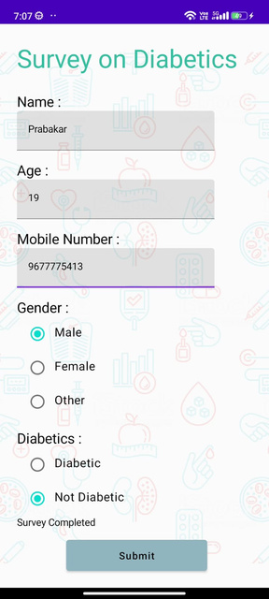
OUTPUT:

